Slide 1



CST 347 – Real Time OS
Lecture 15 – Deadlocks I
Troy Scevers

Slide 2
Topics
System Model
Deadlock Characterization
Methods for Handling Deadlocks
Deadlock Prevention
Deadlock Avoidance
Deadlock Detection
Recovery from Deadlock
Notes:
To develop a description of deadlocks, which prevent sets of concurrent processes from completing their tasks
To present a number of different methods for preventing or avoiding deadlocks in a computer system

Slide 3
System Model
System consists of resources
Resource types R₁, R₂, …, R_{m}
Each resource type R_{i} has W_{i} instances
Each process utilizes a resource as followes
  request
  use
  release
Notes:
Finite number of resources to be distributed among a number of competeing processes.
Each type or class of resource consists of some number of instances. CPU cycles, files, I/O Devices
Dual core CPU would have 2 CPU resource instances. If a process requests an instance any instance of the type should work. Otherwise they are not identical.
2 printers may not matter which output is used (same intance) however if 1 is in the basement and 1 is on 9th floor. People on 9th floor probably won't see them as the same.
Process can request as many resources as are avaialable.
A set of processes is in a deadlocked state when every process in the set is waiting for an event to happen that can be caused by only by another process in the set

Slide 4
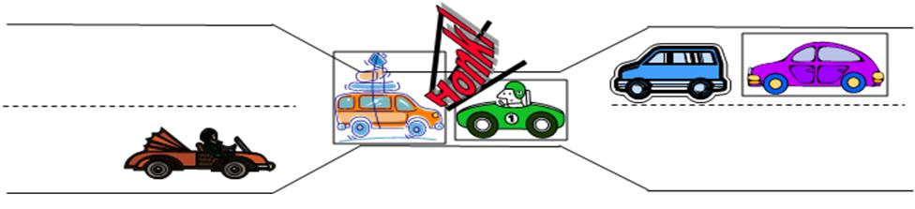
Deadlock

Slide 5
Deadlock Characterization
Deadlock can arise if four conditions hold simultaneously
  Mutual Exclusion
    Only one process at a time can use a resource
  Hold and wait
    A process holding at least one resource is waiting to acquire additional resources held by other processes
  No preemption
    A resource can be released only voluntarily by the process holding it, after that process has completed its task
  Circular wait
    There exists a set {P₀, P₁, …, P_{n}} of waiting processes such that P₀ is waiting for a resource that is held by P₁, P₁ is waiting for a resource that is held by P₂, …, P_{n-1} is waiting for a resource held by P_{n}, and P_{n} is waiting for a resource held by P₀

Slide 6
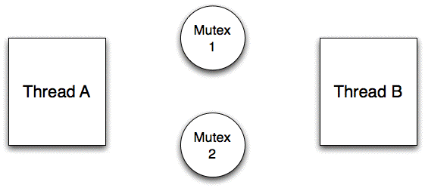
Deadlock with MUTEX locks

Slide 7
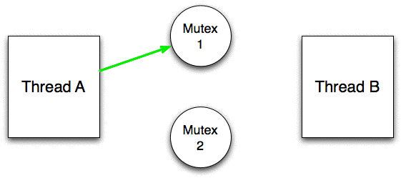
Deadlock with MUTEX locks

Slide 8
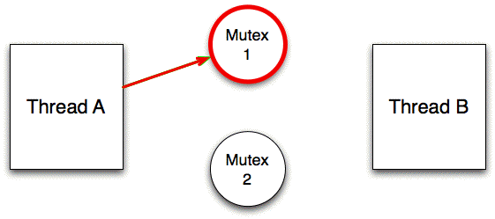
Deadlock with MUTEX locks

Slide 9
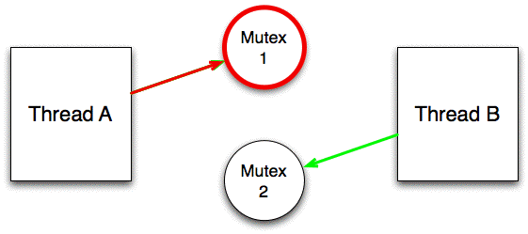
Deadlock with MUTEX locks

Slide 10
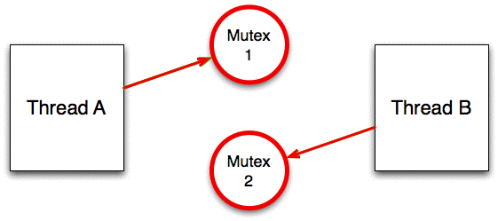
Deadlock with MUTEX locks

Slide 11
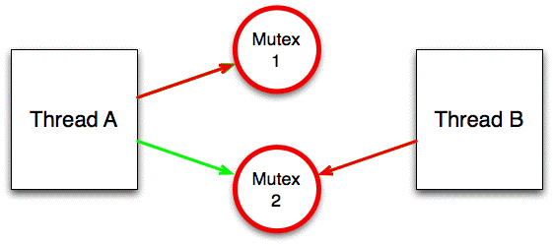
Deadlock with MUTEX locks

Slide 12
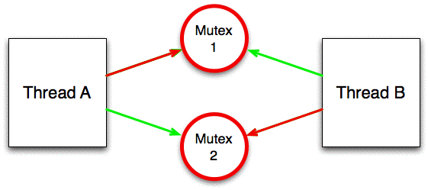
Deadlock with MUTEX locks

Slide 13
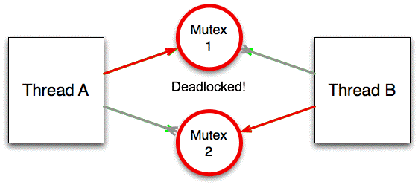
Deadlock with MUTEX locks

Slide 14
Resource-Allocation Graph
Made up of a set of vertices V and edges E
  V is partitioned into two types
    P = { P₁, P₂, …, P_{n}}, the set consisting of all the processes in the system
    R = { R₁, R₂, …, R_{n}}, the set consisting of all the resources in the system
  request edge
    directed edge P_{i} → R_{j}
  Assignment edge
    Directed edge R_{j} → P_{i}
Notes:
Deadlocks can be described more precisely in terms of a directed graph called a system resource-allocation graph

Slide 15
Graphically this becomes
Process
Resource Type with Four Instances
P_{i} requests instance of R_{j}
P_{i} is holding an instance of R_{j}
P_{i}
R_{j}
P_{i}
R_{j}

Slide 16

Example of a Resource-Allocation Graph
Notes:
The sets P,R and E
P = {P1, P2, P3}
R = {R1, R2, R3, R4}
E = {P1 → R1, P2 → R3, R1 → P2, R2 → P2, R2 → P1, R3 → P3}
Cycle is traversing all the way around for intance
P1 → R1 → P2 → end back at P1
If graph contains no cycles, then no process in the system is deadlocked. If the graph does contain a cycle, then a deadlock may exist.
If each resource has 1 instance then a cycle indicates that a deadlock has occurred. If it contains resources with several instances then a deadlock may have occurred.

Slide 17

Example of a Resource-Allocation Graph
Notes:
Added P3 → R2
Now we have two minimal cycles in the graph
P1 → R1 → P2 → R3 → P3 → R2 → P1
P2 → R3 → P3 → R2 → P2
Processes P1, P2, and P3 are deadlocked.
P2 is waiting for resource R3 (held by P3). P3 is waiting for either P1 or P2 to release R2. P1 I waiting for P2 to release R1

Slide 18

Example of a Resource-Allocation Graph
Notes:
Does this Graph contain a cycle?
Does this graph contain a deadlock?
This graph contains a cycle
P1 → R1 → P3 → R2 → P1
No deadlock because P4 could release its R2 lock, which could then be allocated to P3 breaking the cycle. Or conversly P2 could release R1 and accomplish the same thing
If a resource allocation graph has no cycle then a deadlock cannot exist. If it does one may exist...

Slide 19
Basic Facts
If graph contains no cycles → no deadlock
If graph contains a cycle →
  If only one instance per resource type, then deadlock
  If several instances per resource type, possibility of deadlock

Slide 20
Methods for Handling Deadlocks
Ensure your system will never enter a deadlocked state
Allow the system to enter a deadlocked state and then recover
Ignore the problem and pretend that deadlocks never occur in the system
Notes:
Use a protocol to prevent a deadlock from happening
The first requires one of two methods Deadlock prevention or Deadlock avoidance schemes
Second method requires an algorithm that examines the system to determine if a deadlock has occurred and another algorithm to recover from that deadlocked state
Most full OS's use the third method including linux and windows so its left up to the application developer to write programs to handle deadlocks.

Slide 21
Deadlock Prevention
Restrain the ways requests can be made
  Mutual Exclusion
    Not required for sharable resources; must hold for nonsharable resources
  Hold and Wait
    Two approaches
      Require a process to request and be allocated all its resources before it begins execution
      allow process to request resources only when the process has none
Notes:
As stated earlier, each of the four necessary condition must hold for a deadlock to occur. If we ensure that at least one of these conditions cannot hold, we can prevent the deadlock
Sharable resources can have simultaneous access. We connot prevent this first condition from occuring because there are things that need locked access.
2 approaches to Hold and Wait. Allocate all or only allow 1 at a time.
Drawbacks
Low resource utilization;
starvation is possible

Slide 22
Deadlock Prevention
No Preemption
  If a process that is holding some resources requests another resource that cannot be immediatley allocated to it, then all resources currently being held are released
  Preempted reosurces are added to the list of resources for which the process is waiting
  Process will be restarted only when it can regain its old resources, as well as the new ones that it is requesting
Circular Wait
  Impose a total ordering of all resource types, and require that each process requests resources in an increasing order of enumeration

Slide 23
Deadlock Example with lock ordering
void transaction(Account from, Account to, double amount)
{
mutex lock1, lock2;
lock1 = get_lock(from);
lock2 = get_lock(to);
acquire(lock1);
acquire(lock2);
withdraw(from, amount);
deposit(to, amount);
release(lock2);
release(lock1);
}
Notes:
Deadlock is possible if two threads simultaneously invoke the transaction() function. Multicore system

